Slide 1
Public Meeting
NH 0044(203)39 PCN 05Q8
S.D. Highway 44 in Rapid City
Structure Replacement & Approach Grading
Richard Sudmeier, PE
Design Project Manager
October 25, 2022
Notes:
Good evening and welcome to the Public Meeting to discuss planned bridge replacement project on Highway 44.
My name is Richard Sudmeier with FMG Engineering in Rapid City.
Other FMG and SDDOT representatives here with me this evening are:
Sam Irwin, FMG Engineering
Mike Carlson, Area Engineer, Rapid City
Steve Palmer, Engineering Supervisor, Rapid City
Jacob Rosecky, Road Design
Hopefully everyone had a chance to sign in and picked up a handout. Included in the handout is the power point of which you may follow along.

Slide 2
Purpose of the Meeting
Involve the public in the planning and design process
Provide a Project Overview
Background Information
Proposed Project
Project Schedule
Gather Input and Comments
Notes:
We are here tonight to involve the public in the design process. We would also like to share with you the project scope, what the current design layout is, and the schedule. After the presentation we want to gather public input in the form of exchange of ideas and/or discuss any concerns you may have.

Slide 3
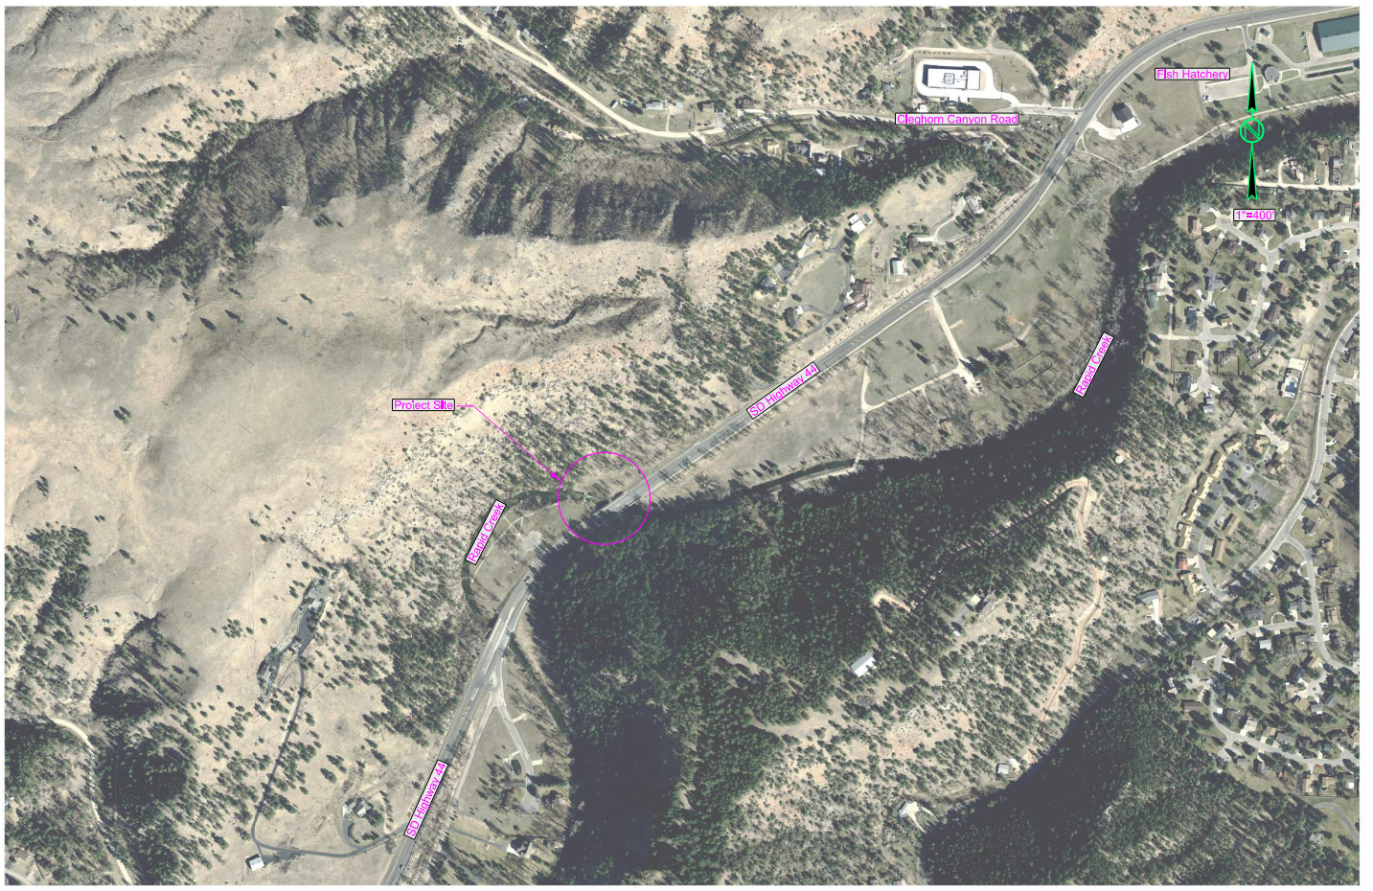
Project Limits
Fish Hatchery
Cleghorn Canyon Rd
Project Site
SD Hwy 44
Notes:
The proposed project is approximately 1 mile west of the Rapid City Fish Hatchery.

Slide 4
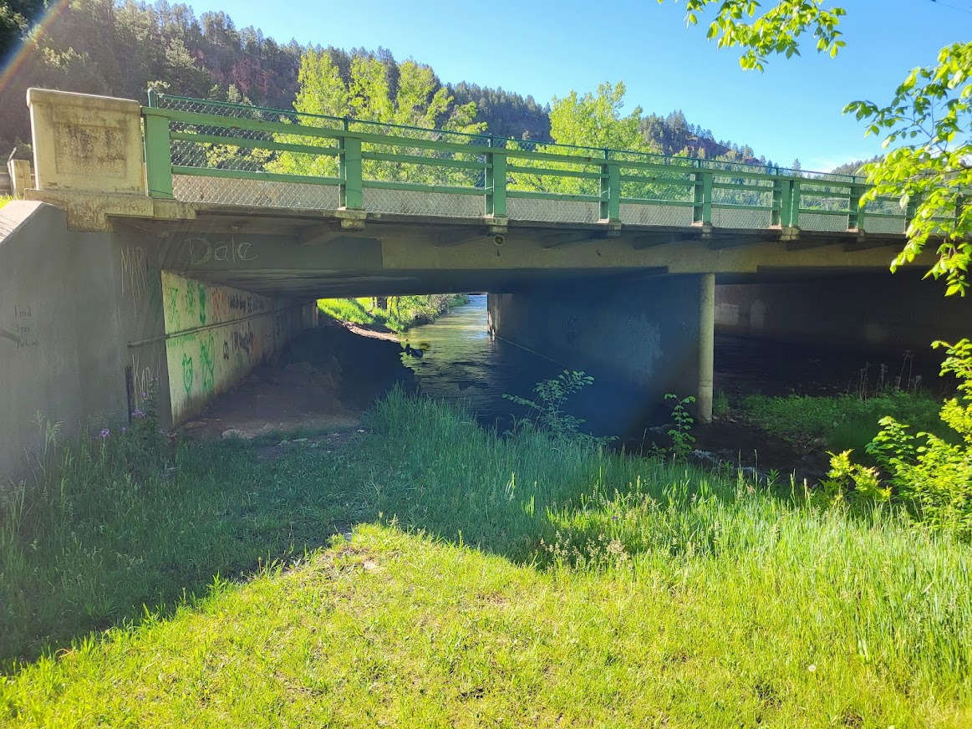
Background Information
Structure Built in 1965
Improvements made to Bridge Barrie in 2000
Notes:
The bridge over Rapid Creek was originally constructed in 1965 with modifications made in 2000.

Slide 5
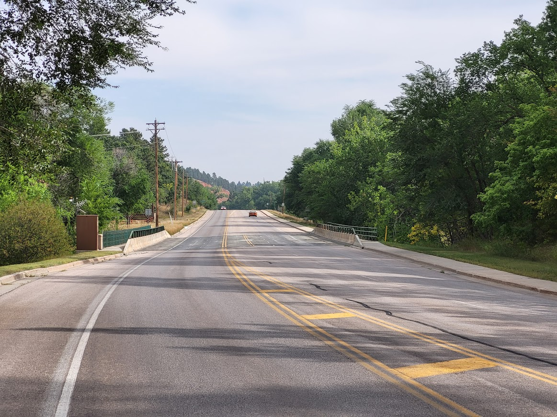
Traffic
2020 Average Daily Traffic (ADT) = 4,816
2044 Projected ADT =
9,350
3.7% Average Truck Traffic
Notes:
The Average Daily Traffic is 4,816 vehicles per day for SD Highway 44. The 20 year projected ADT is 9,350. The average Truck Traffic is 3.7%.
Traffic Volumes and Vehicle Types are used to establish a base line for what type of facility is needed to safely handle traffic now and into the future. For example, the number of lanes, width of lanes, width of shoulders, and surfacing types and thicknesses are all determined by the projected traffic volume and truck percentages.
With the current and projected traffic volumes a 3 lane facility (with 6 foot shoulders) will safely handle the traffic at an acceptable level of service.

Slide 6
Crash History
  1 Reported Crashes
    1 Struck Bridge
  0 Fatalities
  Reported Crash Rate = 0.43
  Statewide Weighted Crash Rate = 1.92 (crashes per million vehicle miles of travel)
5 Year Period from 2014 to 2018
Urban Principal Arterial
Notes:
One crash occurred on the structure in the past years that was due to wintery conditions.

Slide 7
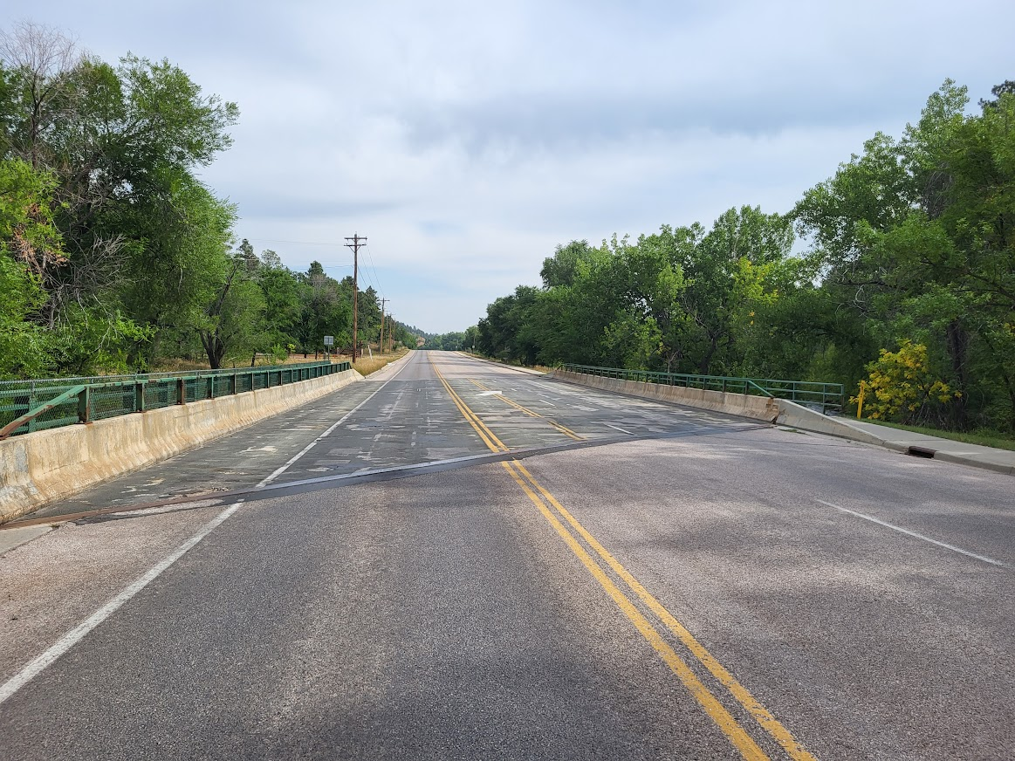
Why We Are Reconstructing
Structure nearing the end of its useful life, and is more economical to replace then rehabilitate
Notes:
The existing structure has many structural deficiencies whereas it has been programed to be replaced.

Slide 8

Proposed Improvements
Replace Structure
Maintain Current Highway Width
Add Sidewalks to Access Cliffside Park
Notes:
Replace structure over Rapid Creek. It was built in 1965. It will be 60 years old at the time of replacement.
Maintain Existing Highway width
Add sidewalks to access Cliffside Park

Slide 9
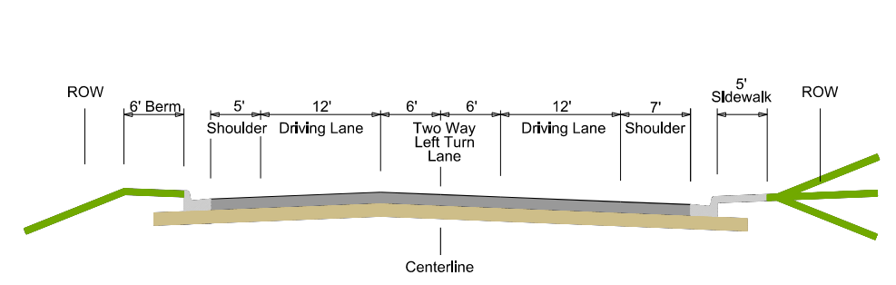
Proposed Typical Section
Notes:
Existing Urban Section
Roadway: 3 – 12 Ft Asphalt Lanes
7’ shoulder on left side
5’ shoulder on right side
C&G on both sides
5’ Sidewalk along right side
Proposed Urban Reconstruction
Roadway: 3-12 Ft (12” Base Course + 6” Asphalt)
7’ shoulder on left side
5’ shoulder on right side
C&G on both sides
5’ Sidewalk along right side
ROW width to stay the same

Slide 10
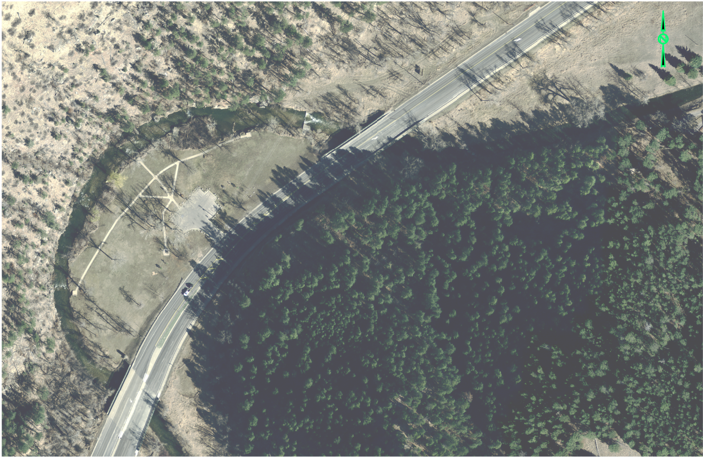
Proposed Pedestrian Facilities
Highway 44
Rapid Creek
Proposed Sidewalk
Cliffside Park
Notes:
As shown in yellow an option for ADA pedestrian facilities are proposed along highway 44 for access to Cliffside Park.
The project proposes a sidewalk starting on the east side of the highway north of the bridge than passes under the bridge north of the creek to connect to a new sidewalk along the west side of the highway. The new sidewalk along the west side of the highway will cross the bridge and connect to the park south of the bridge.
Final determination for the location of the sidewalk under the bridge will depend on constructability, clearance under the bridge, and ability to obtain additional ROW.

Slide 11
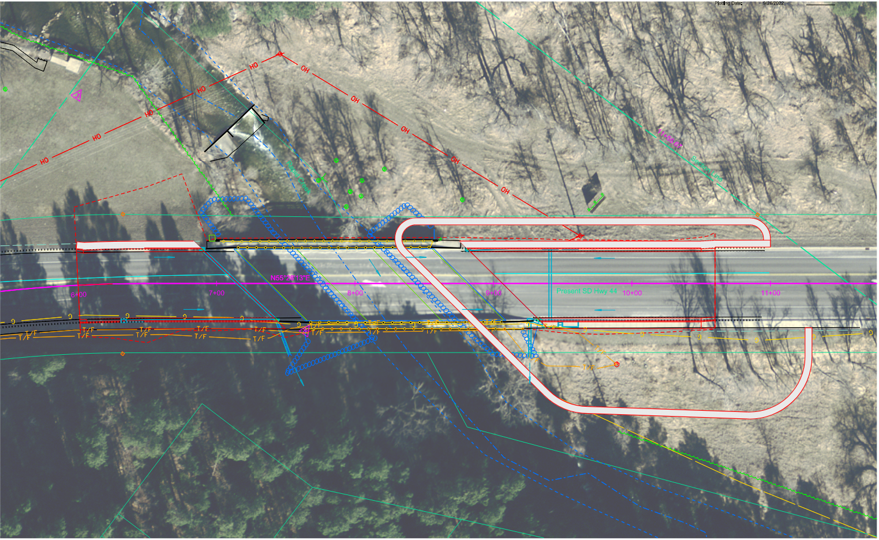
Proposed Pedestrian Facilities
Proposed Sidewalk
Proposed Sidewalk
Notes:
The sidewalk proposed would connect the existing sidewalk along the east side of the highway to the park. During normal creek flow conditions pedestrians will be able to cross under the bridge and use a proposed sidewalk along the west side of the bridge to access the park. During high flow conditions pedestrians will need to cross the highway.

Slide 12
Right of Way (ROW)
Existing Width is 100 feet
Purchase additional ROW as needed
Temporary Easements as needed for construction
See Handout
Notes:
The existing ROW is 100 ft (50’ from centerline).
Temporary easements are necessary whenever the construction work limits are outside of the right of way. Temporary easement allows construction to occur on your property during construction of the highway. The red dashed line represents the limits of work and when this line is near or outside the ROW line temporary easements will need to be obtained by the State.
ROW and Temporary Easements will be discussed in more detail during Individual Landowner Meetings, and more information on the right of way process is available in the handout.

Slide 13
Encroachments
Private Property in Public ROW
Examples
Signs
Private Use (Parking)
Landscaping Items
Notification
Federal Highway Regulations for Safety
Owners of Encroachments will be notified by the Rapid City Area Office
See Handout
Notes:
Encroachment surveys are done during federal aid projects to ensure there are not any items such as signs or landscaping items located within the public ROW. An encroachment survey has done performed with no items found within the ROW.

Slide 14
Utility Coordination
Montana Dakota Utilities
Black Hills Energy
Lumen/Century Link
City of Rapid City
SDN Communications
Some Utilities may need to be relocated
Utility Companies negotiate easements with landowners
See Handout

Slide 15
Utility Coordination
Water Lines
Sanitary Sewer Lines
Septic Tanks
Underground Storage Tanks
Underground Power Lines
Any Known Private Utilities?
Contact SD DOT
See Handout

Slide 16
Environmental, Social and Economic Concerns
This project is being developed in accordance with applicable State and Federal environmental regulations.
National Environmental Policy Act of 1969 (NEPA), as amended.
Section 106 of the National Historic Preservation Act (No historic or archaeological sites will be impacted by the project)
See Handout
Notes:
Section 106
As stated in slide, this is specific to the protection of historic properties. Which will include: districts, sites, structures, and objects of historic & archaeological significance. This will also include tribes that may attach religious or cultural importance to them. Invite the public to provide information on any culturally or archaeologically known site(s).
Contaminated Materials
Request public’s input to any known AST or UST tanks within vicinity of project.

Slide 17
Environmental, Social and Economic Concerns
Section 404 of the Clean Water Act
Section 4(f) of the USDOT Transportation Act of 1966 (The Adjacent City Park is a Section 4(f) resource. No permanent impact to the Park is anticipated)
See Handout
Notes:
Section 106
As stated in slide, this is specific to the protection of historic properties. Which will include: districts, sites, structures, and objects of historic & archaeological significance. This will also include tribes that may attach religious or cultural importance to them. Invite the public to provide information on any culturally or archaeologically known site(s).
Contaminated Materials
Request public’s input to any known AST or UST tanks within vicinity of project.

Slide 18
Environmental, Social and Economic Concerns
Section 7 of the Endangered Species Act
  The U.S. Fish and Wildlife Service will review the project to determine if it will impact the following species that are known to occur in Pennington County:
  Birds: Red Knot
  Mammals: Northern Long-Eared Bat
  Butterflies: Monarch Butterfly
  No impacts are anticipated to these species by the project.
See Handout
See Handout

Slide 19
Construction Traffic Control
Phased Construction
Construct a portion of the bridge and roadway
Traffic will be diverted to the portion not under construction
Notes:
The goal of the project will be to two-way traffic during construction. There may be instances where one-way traffic with stop lights may be needed depending on structure integrity of the existing bridge, and design of the proposed bridge. Vehicle access to the park will be maintained.

Slide 20
Landowner Meetings
Landowners adjacent to the project will be contacted individually by SDDOT to schedule a meeting
Discussion Items:
Driveway locations/widths
Drainage
Trees
Temporary Easements or ROW acquisition
See Handout

Slide 21
Tentative Project Schedule
Dependent on Federal Funding
January 2023
Landowner Meetings
Spring 2023
Final Design
2023 to 2024
ROW Acquisition
2026
Construction
Estimated Cost: $5.5 million
Notes:
The tentative project schedule is shown here.
Dates where there will be additional involvement between SDDOT and adjacent property owners are:
Landowner Meetings to be held in the Winter of 2023
ROW Acquisition Process will begin in the summer of 2023
The construction is scheduled for the 2026 construction season.

Slide 22
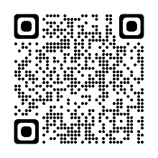

Public Input
Submit Questions and/or Comments:
by:
November 14, 2022
to:
Richard Sudmeier
FMG Engineering
3700 Sturgis Road
Rapid City, SD 57702
rsudmeier@fmgengineering.com
  Public Meeting Information can be found at:
https://dot.sd.gov/projects-studies/projects/public-meetings
Notes:
At this time I will take any general comments or question you may have on this project. If you have any specific questions or comments regarding how the projects may impact your property we will take the remaining time to visit with you one on one at either one of the aerial layouts.
You are also asked to submit your questions or comments in writing on the form provided in the handout or via email address to Richard Sudmeier, rsudmeier@fmgengineering.com (2 weeks) .
In the next few days the power point presentation, handout and design layouts will be added to the web site address noted. Go to the section under Rapid City Region and click on the link to the project.

Slide 23
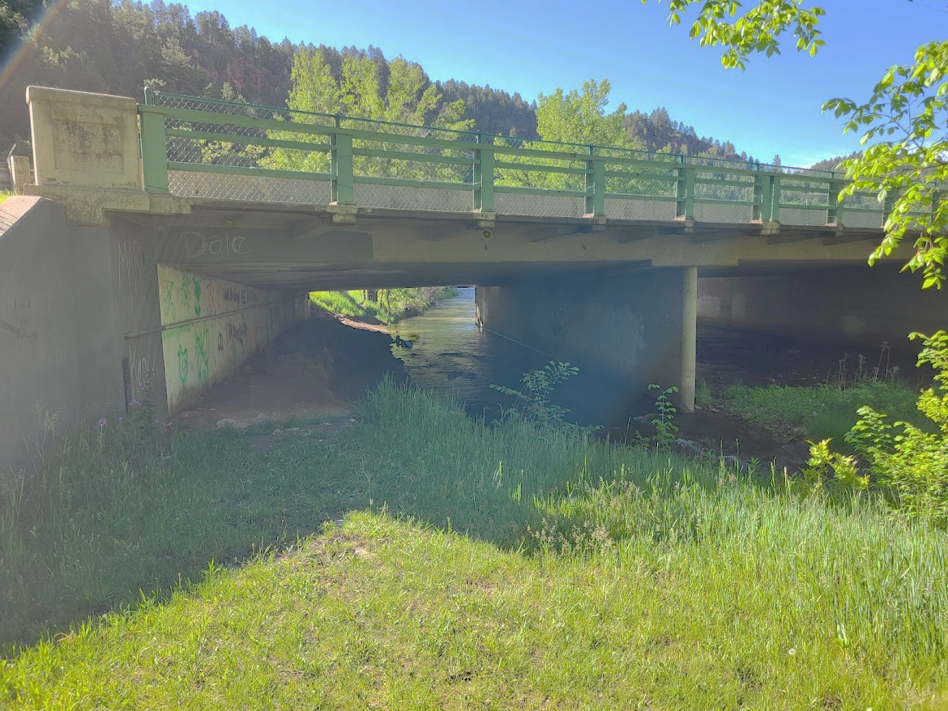

Public Input
Please Submit Questions or Comments by
November 14, 2022 to:
Richard Sudmeier
FMG Engineering
3700 Sturgis Rd. Rapid City, SD 57702
rsudmeier@fmgengineering.com
Public Meeting Information can be found at:
https://dot.sd.gov/projects-studies/projects/public-meetings#listItemLink_1822
Notes:
At this time I will take any general comments or question you may have on this project. If you have any specific questions or comments regarding how the projects may impact your property we will take the remaining time to visit with you one on one at either one of the aerial layouts.
You are also asked to submit your questions or comments in writing on the form provided in the handout or via email address to Richard Sudmeier by November 14, 2022 (2 weeks)
The power point presentation, handout and design layouts are located at web site address noted. Go to the section under Rapid City Region and click on the link to the project.

