Slide 1
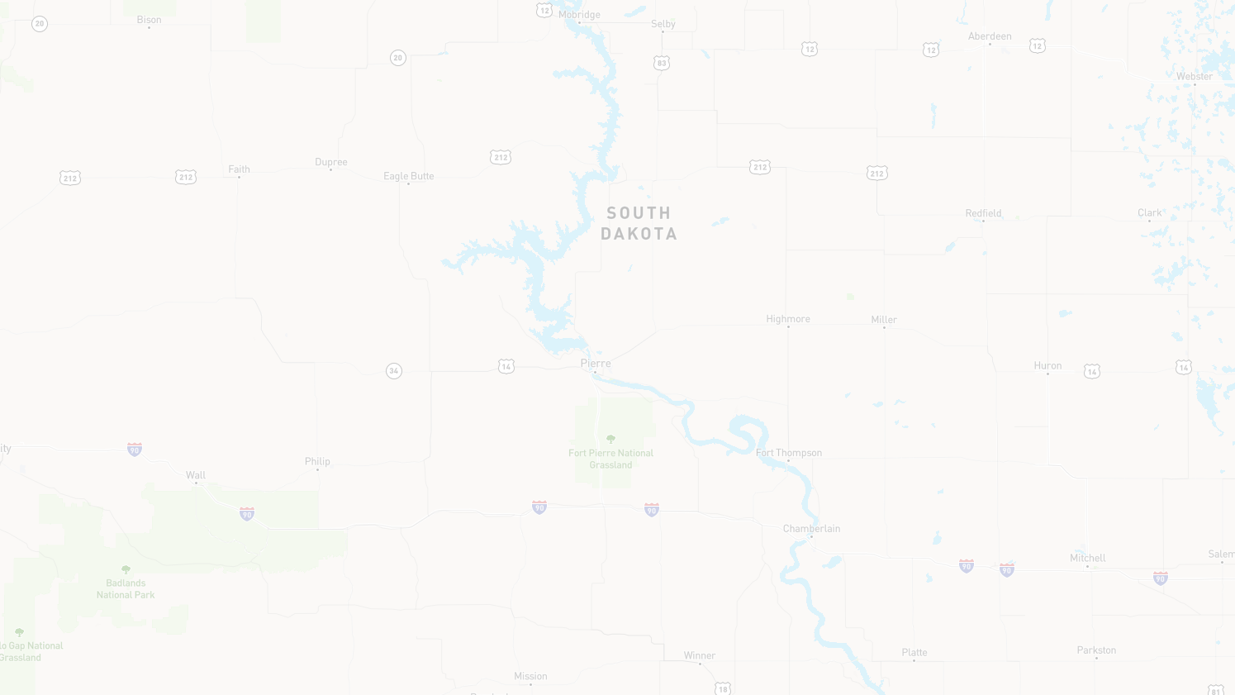

US Highway 18
From the East Junction of SD73 to West of Antelope Road/242nd Ave
Mark Malone, PE
SOUTH DAKOTA DEPARTMENT OF TRANSPORTATION

Slide 2
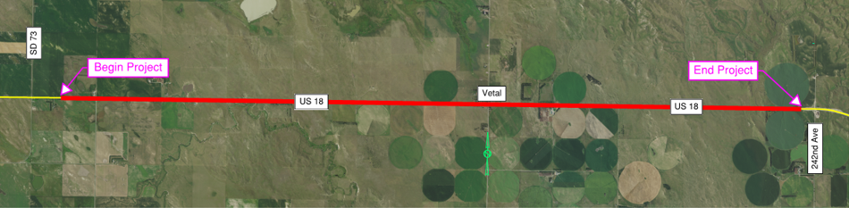

Project Limits
Project Length = 11.3 Miles

Slide 3


Why are we here?
Involve the public in the design process
Exchange ideas – listen and discuss concerns
Provide a Project Overview
  Background Information
  Proposed Project
  Project Schedule
Gather Input and Comments

Slide 4
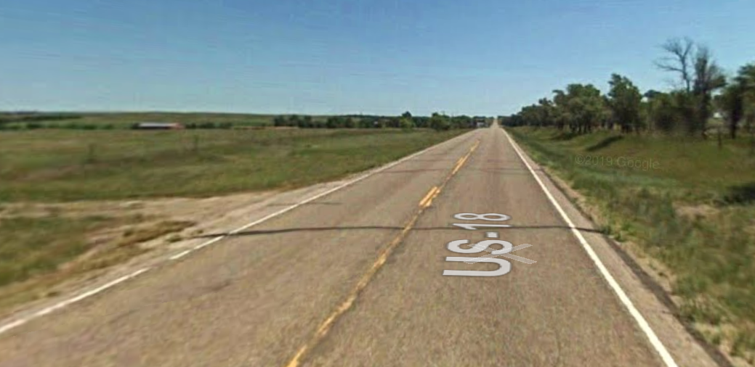
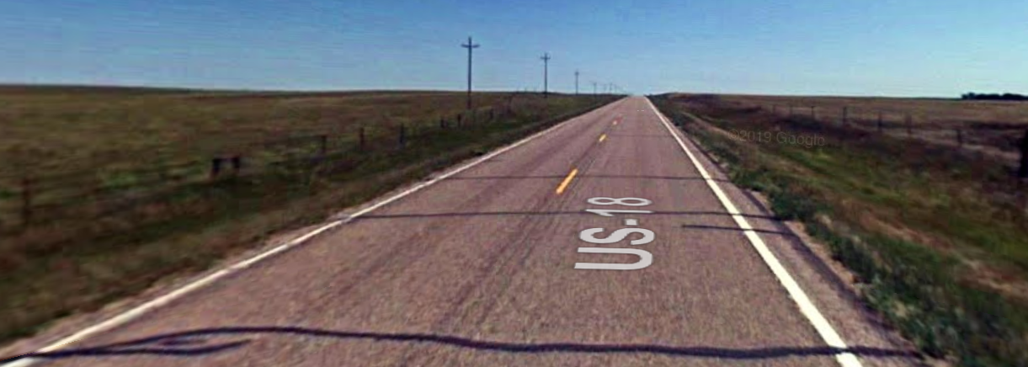
Highway Deficiencies
Narrow Shoulders – 2 & 3 feet
Narrow Right Of Way
Vertical Curves
Pavement Condition
Shallow Ditches
Snow Drifting

Slide 5
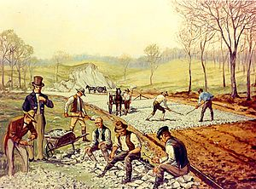
Background Information
Grading in 1947
Resurfaced in 1980 & 2001

Slide 6
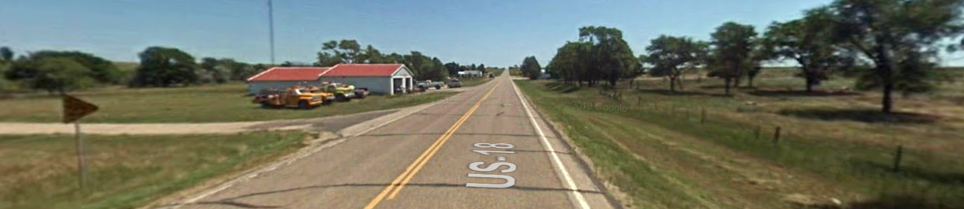
Traffic
2020 Average Daily Traffic (ADT) = 565
25 Year Projected ADT = 664
13.9% Trucks

Slide 7
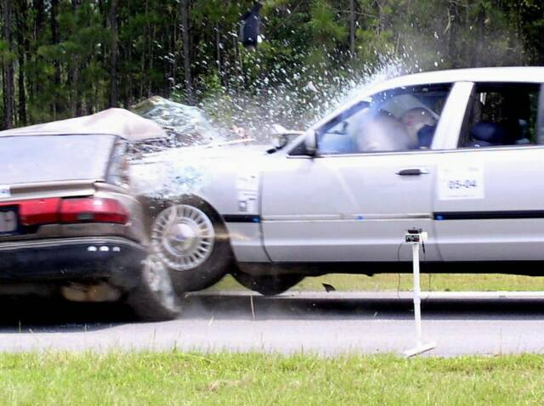
Reported Crash History
5 Year Period from 2016 to 2020
  16 Reported Crashes
    9 Animal Hits
    1 Cross Centerline
    0 Overturn/Rollover
    3 Ran Off Road
    3 Other
  1 Fatality
  4 Injuries
Rural Major Arterial
  Reported Crash Rate = 2.95
  Statewide Weighted Crash Rate = 1.46
(crashes per million vehicle miles of travel)

Slide 8
Proposed Improvements
Widen Roadway – 6 feet Shoulders
Flatten Highway Curves
Replace Culverts and Fence
Vetal Improvements
  Curb and gutter
  Parking
  Lighting
New Asphalt surfacing year after construction

Slide 9
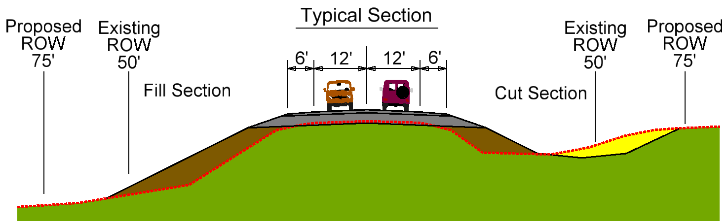
Proposed Typical Section

Slide 10
Access Management
To provide safe, efficient access to streets and highways
Limit number of direct accesses to major roadways
Provide adequate spacing between driveways and cross-roads
See Handout on website

Slide 11
Right of Way (ROW)
Existing Width:
  100 feet
  80 to 90 feet in Vetal
Purchase additional ROW to 150 feet
Maintain Existing Width in Vetal
Purchase additional ROW around
highway embankment & pipes
Temporary Easements as
needed for construction
See Handout on website

Slide 12
Encroachments
Encroachments - Private Property Located Within the Public ROW
  Federal Highway Regulations
  Safety
Examples of Encroachments
  Signs
  Private Use (Parking)
  Landscaping Items
Owners of Encroachments will be Notified by the Winner Area Office
See Handout on website

Slide 13
Utility Coordination
Some Utilities may need to be relocated
Utility Companies may negotiate easements with landowners as needed
Golden West Communications
LaCreek Electric
See Handout
on website

Slide 14
Utility Coordination
Any Known Private Utilities?
  Waterlines
  Drainfields
  Septic Tanks
  Underground Storage Tanks
  Underground Power Lines
  Contact SDDOT
See Handout on website

Slide 15
Environmental, Social & Economic Concerns
This project is being developed in accordance with applicable State and Federal environmental regulations.
In accordance with the National Environmental Policy Act of 1969 (NEPA), as amended. Coordination has been initiated with State & Federal resource agencies.
See Handout on website

Slide 16
Environmental, Social & Economic Concerns
A cultural resources survey will be conducted.
The project is being reviewed to determine extent of impacts to wetlands, game production areas, etc.
Endangered and Threatened Species:
  Mammals: Northern Long-eared Bat
  Birds: Whooping Crane, Rufa Red Knot
  Plants: Western Prairie Fringed Orchid
  Insects: American Burying Beetle
See Handout on website

Slide 17
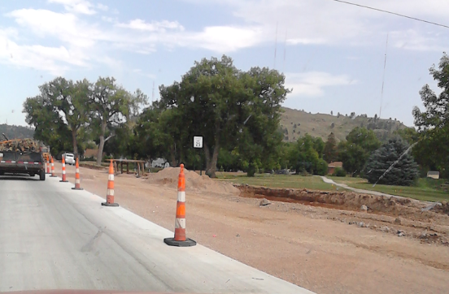

Construction/Traffic Impacts
1 Construction Season
Traffic maintained through the project
Slower traffic anticipated – expect delays
Pilot car & flaggers with one lane traffic at times
Width restriction

Slide 18
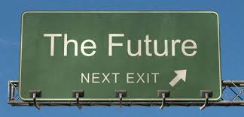

Landowner Meetings | Late Fall 2021
Final Design | 2022
ROW Acquisition Process | 2023
Construction | 2025
Estimated Cost: | $14.9 M
Dependent on Federal Funding

Slide 19
Landowner Meetings
Late Fall/Early Winter 2021
  Affected property owners will be contacted by SDDOT to schedule appointment
Held with individual landowners adjacent to the project to discuss:
  Driveway or access location/width
  Fence
  Drainage
  Temporary Easements
  ROW acquisition
See Handout on website

Slide 20
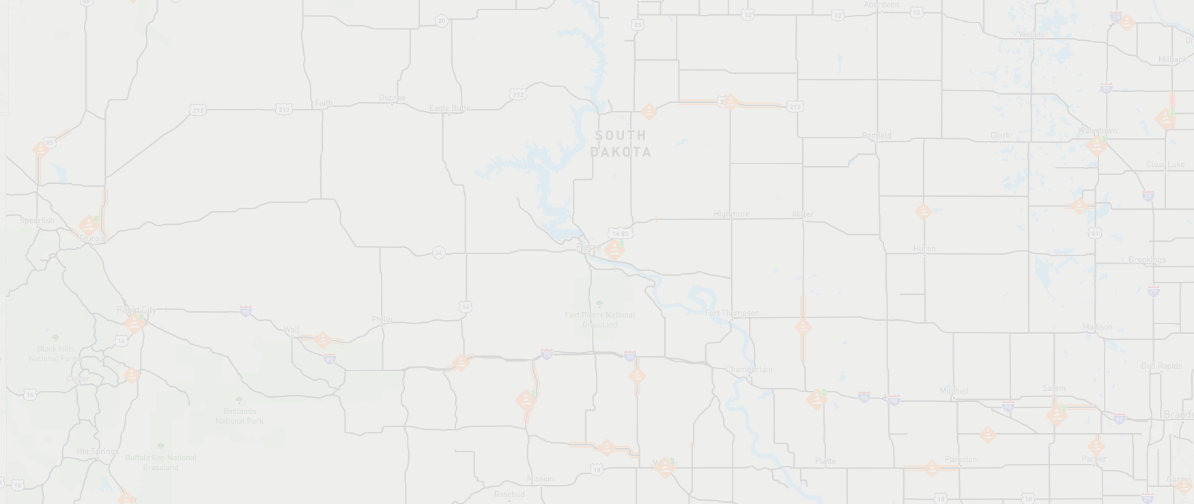
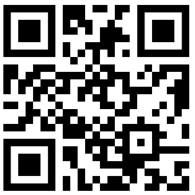
CONTACT INFORMATION
Comments Due July 7, 2021
Mailing Address
700 E Broadway Ave, Pierre, SD 57501
Email Address
Mark.Malone@state.sd.us
Phone Number
(605) 773 5409
Website (Project Information)
https://dot.sd.gov/projects-studies/projects/public-meetings

